Slide 1
M10

Slide 2
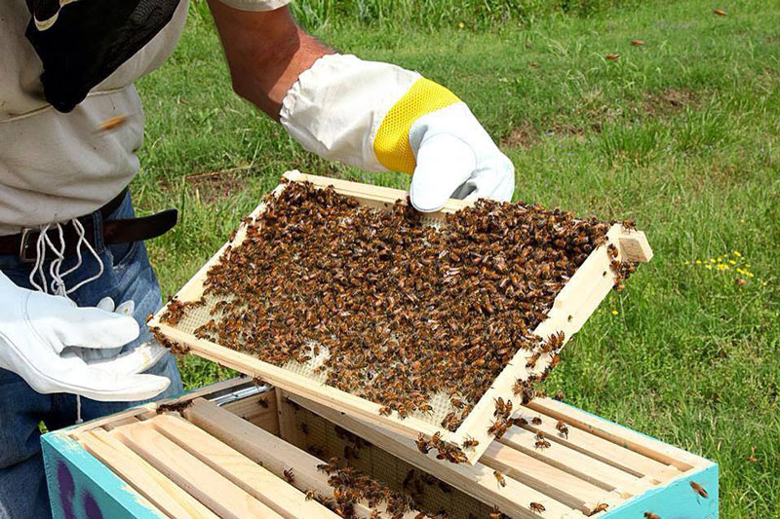
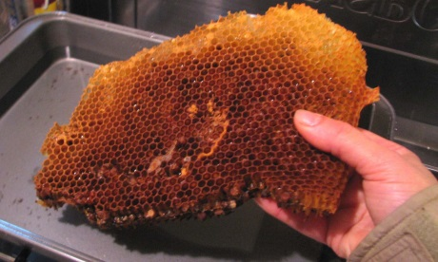
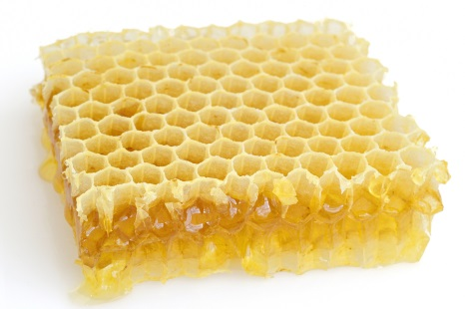
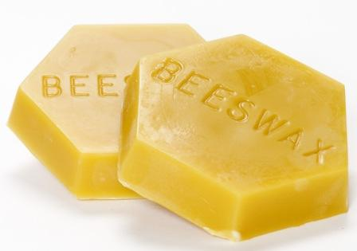
Bee-keeping :
Honey is widely used and therefore bee-keeping for making honey has become an agricultural enterprise.
Since bee-keeping needs low investments, farmers use it as an additional income generating activity.
In addition to honey, the beehives are a source of wax which is used in various medicinal preparations.

Slide 3
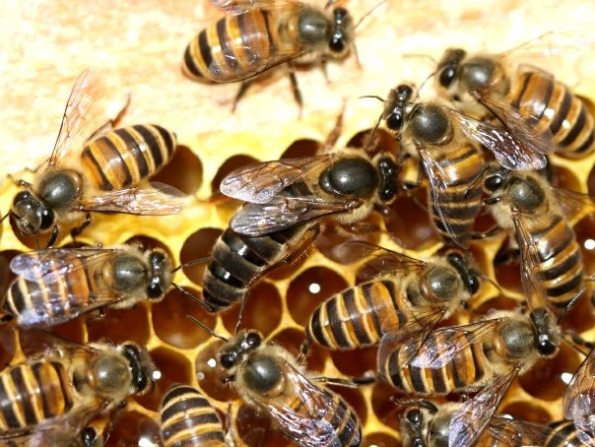
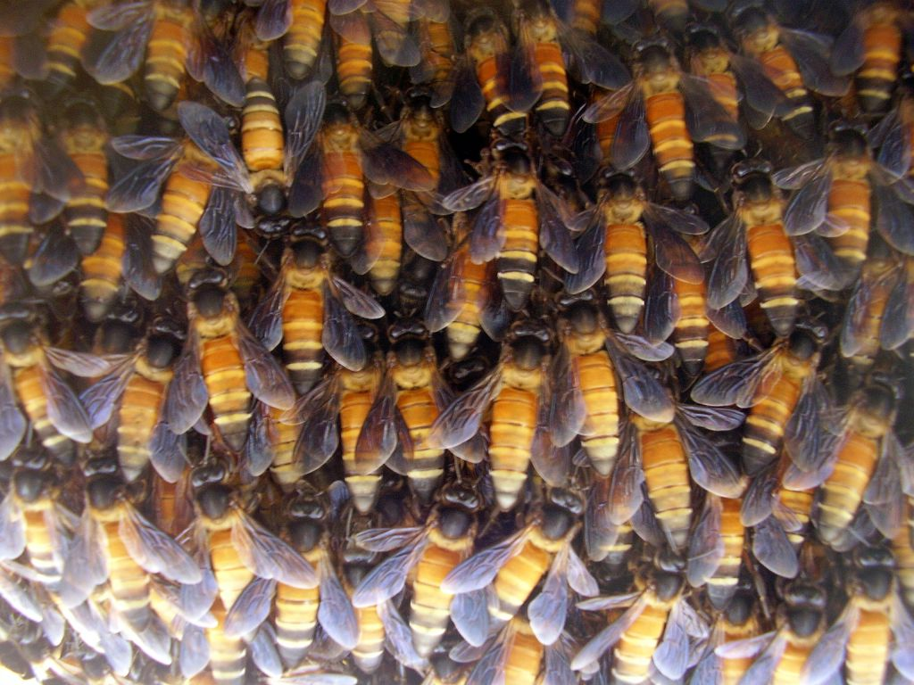
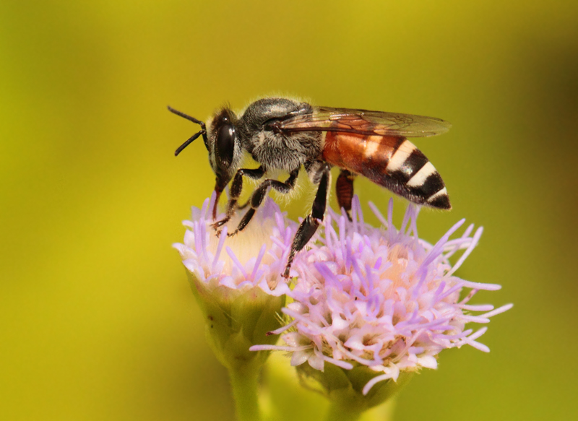
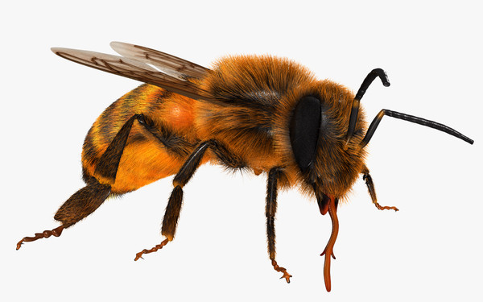
Bee-keeping :
The local varieties of bees used for commercial honey production are Apis cerana indica,
commonly known as the Indian bee,
Apis dorsata,
commonly known as the rock bee
and Apis florae,
commonly known as the little bee.
An Italian bee variety, Apis mellifera, has also been brought in to increase yield of honey.
This is the variety commonly used for commercial honey production.

Slide 4

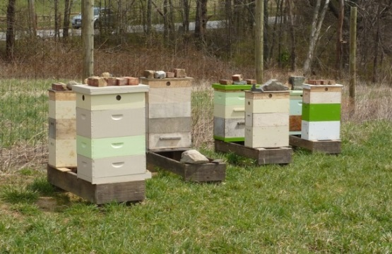
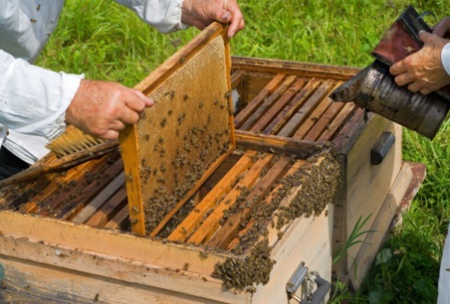
Bee-keeping :
The Italian bees have high honey collection capacity.
They sting somewhat less.
They stay in a given beehive for long periods, and breed very well.
For commercial honey production, bee farms or apiaries are established.

Slide 5
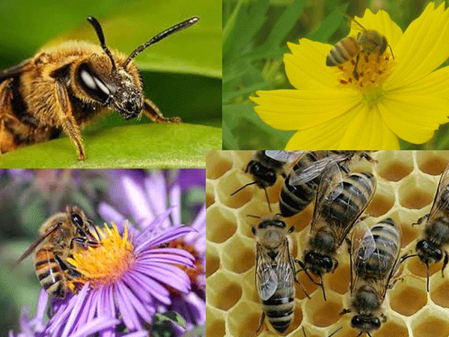
Bee-keeping :
The value or quality of honey depends upon the pasturage, or the flowers available to the bees for nectar and pollen collection.
In addition to adequate quantity of pasturage, the kind of flowers available will determine the taste of the honey.

